Slide 1
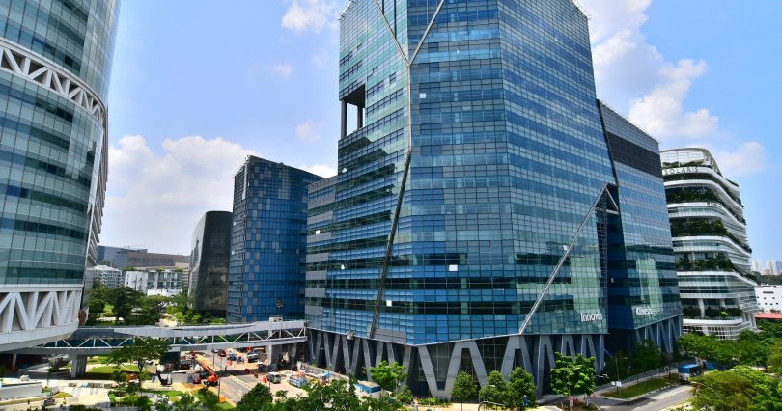


Understanding of EEG Signal variation over days and subjects for general classification purpose
Bharat Nagaraju -A0178258N
Chan Su-Wen Philemon - A0110588E
Vignesh ram andiappan selvaraj -A0178215A

Slide 2
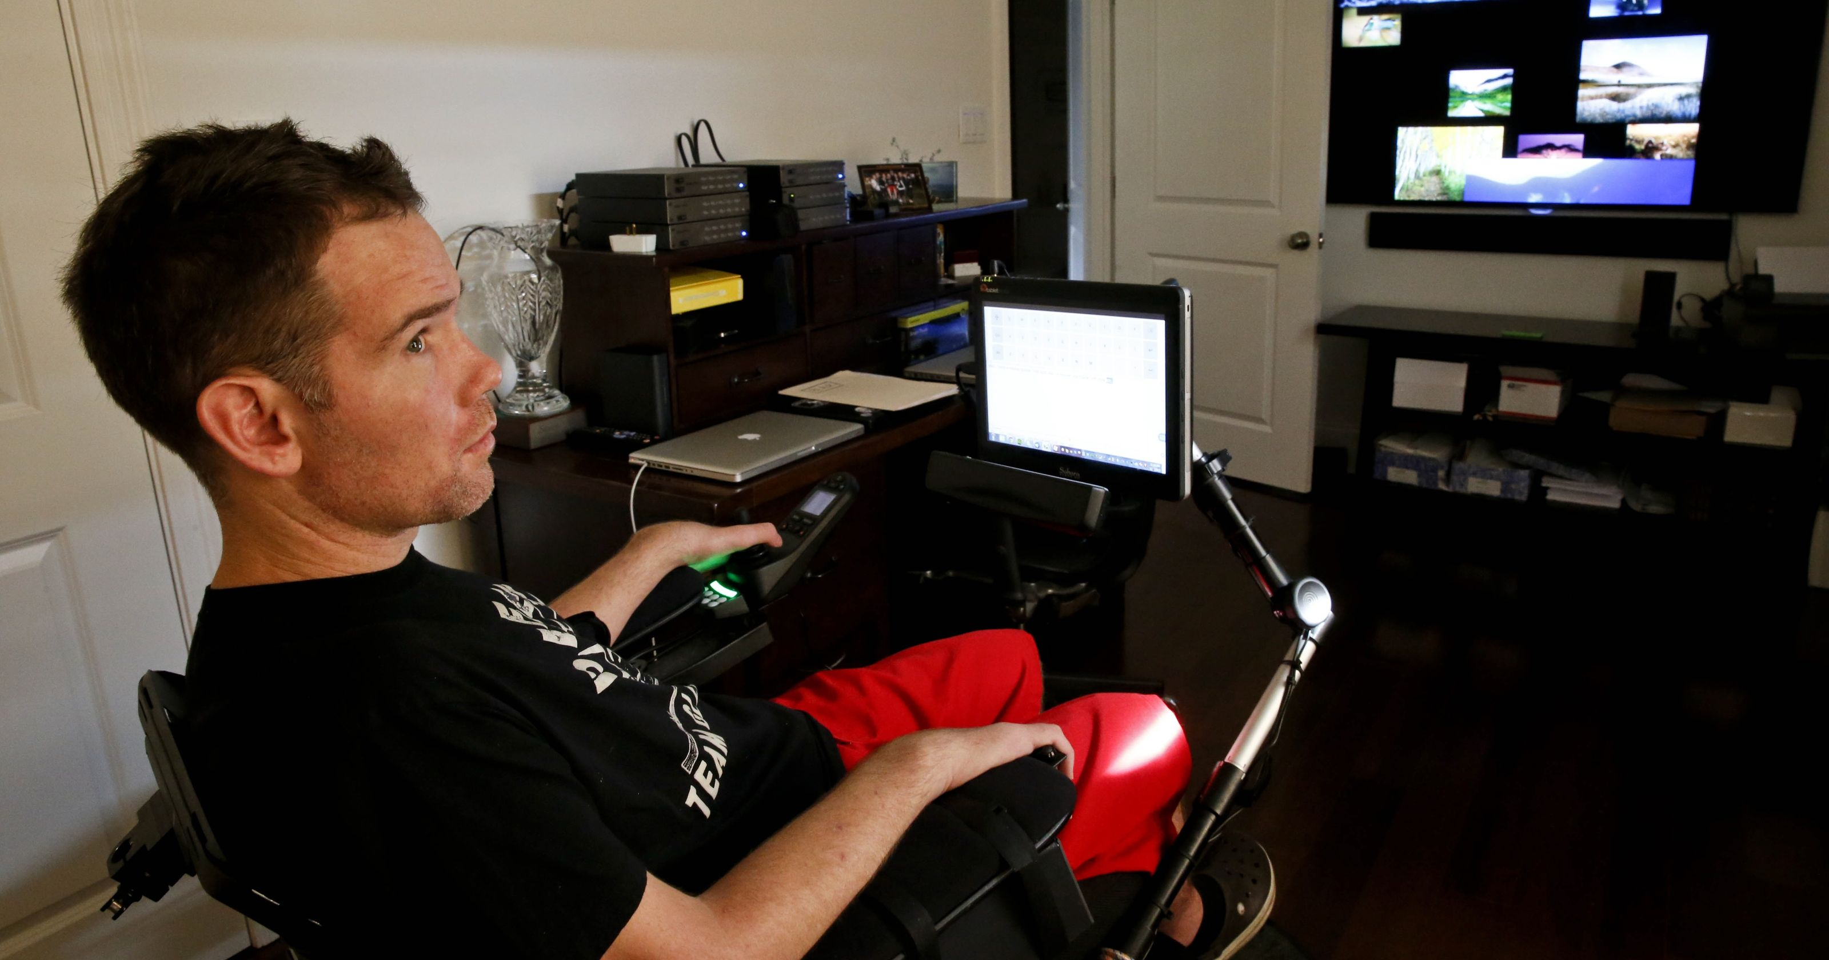
Problem Description
Help patients with neurological disabilities perform basic activities of daily life
Currently, there are no realistic, affordable or low-risk options
Machine Learning Algorithms for classifying different EEG signals produced by brain for different activities
Brain-computer interface (BCI) system to provide communication method for conveying brain messages
Figure 1: Patient with neurological disabilities

Slide 3
Challenges
Inconsistent EEG patterns due to a varying level of subject’s awareness and mental status.
Placement of electrodes (i.e. position on the subjects' scalp)
may vary from day to day and person to person.
Electrodes might short circuit each other.
eeg signals of ALS patient may be associated with the wrong movement imagined due to their inability to hear, see or react correctly.

Slide 4
Project Scope and Objectives
Decode electroencephalogram (EEG) signals
To develop a brain computer interface (BCI) system to aid patient’s mobility.
No Integration with any device
EEG signals are received and stored
Pre-processing, training and validation to build models to classify EEG
Build model to predict subject’s action (i.e. grasping or lifting using Open Source data)
Develop an Inter Subject EEG classification system for A*STAR
To aid future development of decoder for brain signals for patients with ALS
To decode brain signals for same patient with ALS over multiple days.

Slide 5
Solution Outline
Approach 1:
Build a model that can classify various actions of the subject and ignore any variation in readings of the subject (Open Source)
Approach 2:
Derive a transfer function which when applied on a given day shall yield the EEG readings of the subject of another day, if such function exists (For A Star).
Validation Method:
Train neural network and validate against test data to cross check whether desired results are achieved.

Slide 6
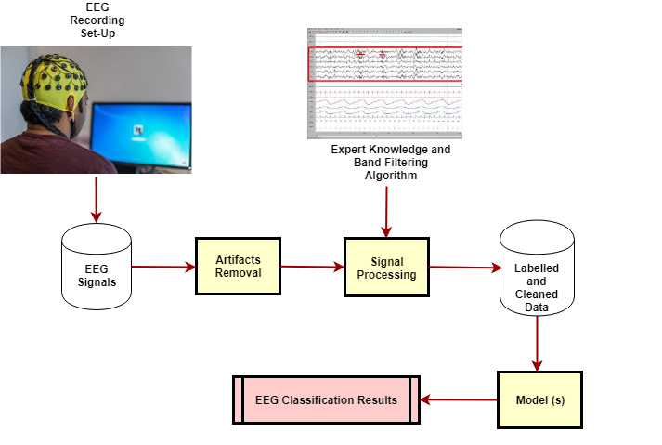
EEG Signal Processing and Model Data Workflow

Slide 7

Related Work (Open Source Dataset)
Various signal processing pipelines are utilized in experiments found in the literature, but the main stages are roughly the same. The transformations applied to the raw digital EEG signal can be divided into the following steps
Artifact rejection
Time-domain filtering
Spatial filtering
Class feature generation
Classification

Slide 8
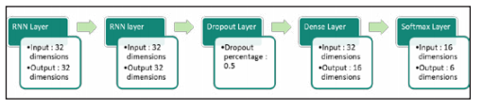
LSTM RNN Algorithm
LSTM is an RNN architecture that is composed of memory blocks which uses gating units with a self-connected memory cell
LSTM solves the vanishing gradient problem that traditional RNNs suffer.
Fast Fourier transform is used to differentiate frequency bands such as delta, theta, alpha, beta and gamma.
For consistent and smooth predictions of phases during transitions, moving averages of predictions instead of using just the prediction for one point.

Slide 9
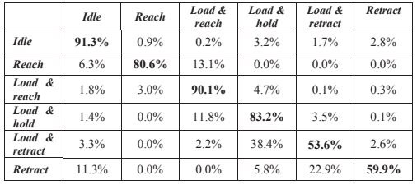
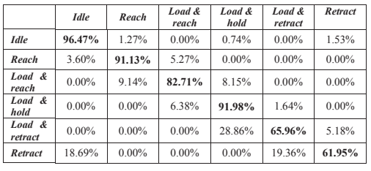
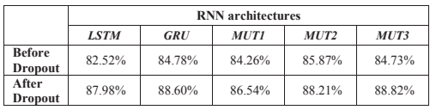
LSTM RNN Algorithm

Slide 10
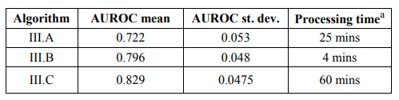
Comparison of Algorithms
Results of the algorithms show that the pre-processing such as filter banks or CSP increase the detection accuracy
ANN shows the best performance out of 3 algorithms.
Time or frequency-domain analysis of the inter-layer activations could help to understand the ANN working process.

Slide 11
Problem solving Paradigm – Healthy subjects
A 3-level classification architecture will be deployed as below.
Level 1 : Models are subject-specific (i.e. trained independently on each subject). Goal is to provide support and diversity for level 2 models.
Level 2 : Global models (i.e. not subject-specific). Main goal is to consider the temporal structure and relationship between events.
Level 3 : Models are ensemble on level 2 predictions via an algorithm that optimizes level 2 models' weights to maximize AUC and reduce the over fitting.
Then the model is trained over ALS patient’s data after pre-processing and modelled to identify the transfer function

Slide 12
Technical Architecture and Design
Figure 8: Diagram of technical architecture

Slide 13
Technical Architecture and Design
Data Pre-Processing
Raw data is well structured and cleaned
Signals contain noise of varying frequency and should be pre-processed
Very high sampling frequency of the EEG compared to relatively low rate of change of the performed action can create issues
To process the data:
First step is to filter the data with a low-pass filter.
Next, Balance the data by subsampling (i.e. we can keep only one data point every 100,500, etc.)
Remove the singularity of the data (i.e. exclude bad trials by inspection and eliminate noise based on certain rules)

Slide 14
Technical Architecture and Design ( Open Source)
Modelling
Level 1: validation mode models are trained on series 1-6 and predictions are produced on series 7-8 - these predictions are the training data for level 2 models. The testing mode trains models on series 1-8 and predicts on test series 9-10.
Cov - Covariance matrices are features used for detection of hand movement from EEG.
FBL – as signal contains predictive information at low frequencies. It consists of concatenating results from applying several 5th order Butterworth lowpass filters
FBLC - Filter Bank and Covariance matrices features concatenated into a single feature set.
LDA (with different normalizations applied) built on above features provided an event-specific view on the data.
CNN - a small 1D/2D convolutional neural network
(input -> dropout -> 1D/2D conv -> dense -> dropout -> dense -> dropout -> output) that is trained onpast samples.

Slide 15
Technical Architecture and Design ( Open Source)
Modelling
Level 2: Models are trained on predictions of level 1 models. They are trained in validation and test modes.
AdaBoost - gradient boosting machines provide performance and diversity for next level models. By heavily subsampling input data, we introduce regularization and reduce overfitting.
RNN – RNNs are computationally inexpensive and achieve a very high AUC. The RNN architecture can be modified as follows (input -> dropout -> GRU -> dense -> dropout -> output).
CNN - shallow (single convolution layer without pooling, followed by single dense layer) will be trained on a subsampled history time course of 3s.
Level 3
Level 2 predictions are ensembled using Random Forest or such algorithms to maximize AUC and reduce overfitting.
Reinforcement Learning:
Base model ( CNN or Stacked) will be trained on patient’s data online and will learn the hand movement

Slide 16
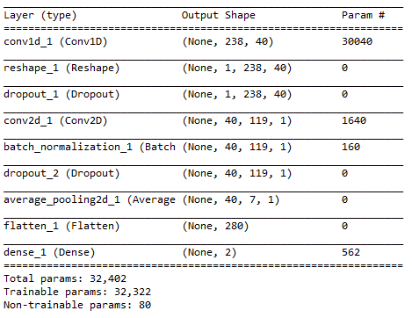
Technical Architecture and Design ( A Star)
Modelling

Slide 17
Implementation
Working on a reinforcement learning model
Implementation of the above design shall use the below packages:
Py-Torch (Deep Learning Modelling)
Spark (For data processing and Sub sampling , Cleansing)
MNE (Filter Band implementations for EEG)
Magnetoencephalography (MEG) and Electroencephalography (EEG) in python
Python (All of the above code and any supplementary packages such as Matplotlib, Scikit-Learn)

Slide 18
Future Work
If model is accurate, BCI can be extended to patients affected by seizures and epilepsy
Other use cases such as Emotion recognition

Slide 19
Thanks
References:
https://www.nature.com/articles/sdata201447
https://www.kaggle.com/c/grasp-and-lift-eeg-detection
https://github.com/alexandrebarachant/Grasp-and-lift-EEG-challenge
https://www.researchgate.net/publication/303363213_Pushing_the_limits_of_BCI_accuracy_Winning_solution_of_the_Grasp_Lift_EEG_challenge
https://ieeexplore.ieee.org/document/7425963
https://ieeexplore.ieee.org/document/7844566
https://ieeexplore-ieee-org.libproxy1.nus.edu.sg/stamp/stamp.jsp?tp=&arnumber=7425963
https://jimmysuen.github.io/
https://github.com/hjweide/kaggle-grasp-and-lift

Slide 20
Related Work – Appendix – Results of various Algorithms
For A-Star Dataset,
M. Arvaneh, C. Guan, K. K. Ang, and C. Quek, “EEG Data Space Adaptation to Reduce Intersession Non-stationarity in Brain-Computer Interface, Neural Computation, Vol. 25, No. 8, pp. 2146-71, August 2013.
M. Arvaneh, C. Guan, K. K. Ang, and C. Quek, “Optimizing Spatial Filters by Minimizing Within-class Dissimilarities in EEG-based BCI”, IEEE Transactions on Neural Networks and Learning Systems, vol. 24, no. 4, pp. 610-619, April 2013.
For Open Source Dataset,
Comparison of Algorithms – Logistic Regression with Band-Pass Filter Bank
Comparison of Algorithms Algorithms – Logistic Regression with Low-Pass Filter Bank
Comparison of Algorithms Algorithms – Normalization and a Convolutional Neural Network

Slide 21
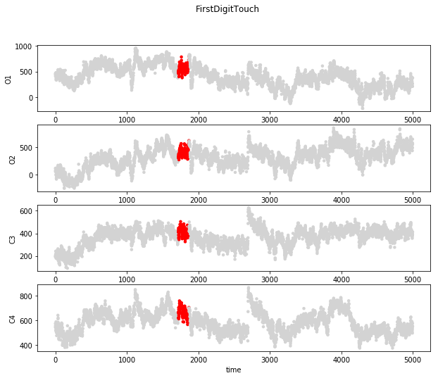
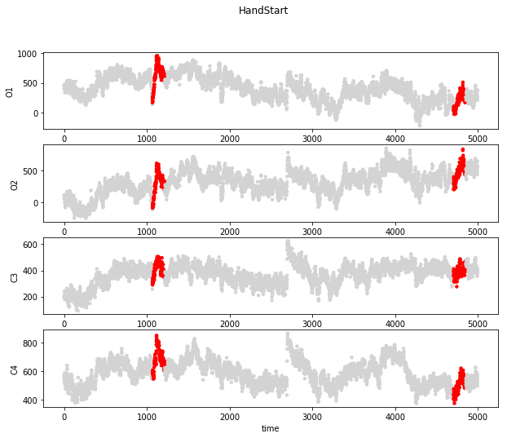
EDA – Open Source

Slide 22
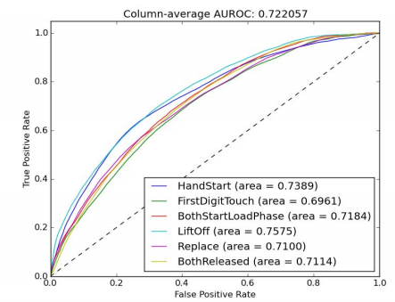
Comparison of Algorithms – Logistic Regression with Band-Pass Filter Bank
Band-Pass Filter Bank with Logistic Regression.
The artifacts are rejected setting the signal value to zero when it exceeds certain limits.
The spatial filtering is done using the CSP method.

Slide 23
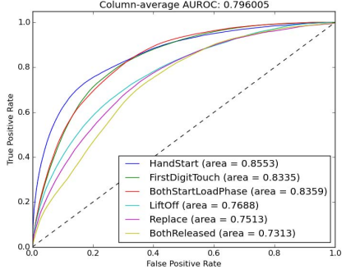
Comparison of Algorithms Algorithms – Logistic Regression with Low-Pass Filter Bank
Band-Pass Filter Bank with Logistic Regression.
The artifacts are rejected setting the signal value to zero when it exceeds certain limits.
The time-domain filtering is performed by a filter bank with fourteen IIR filters.
There is no explicit spatial filtering.

Slide 24
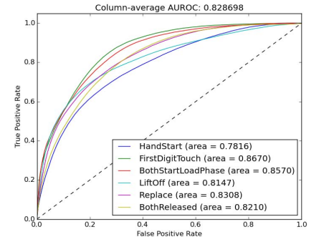
Comparison of Algorithms Algorithms – Normalization and a Convolutional Neural Network
The principle behind this method is to find the relevant features in the signal by itself.
The artifacts are rejected setting the signal value to zero when it exceeds certain limits.
6 layers: input, convolution, maxpool, dense, dense, and output.

Slide 25
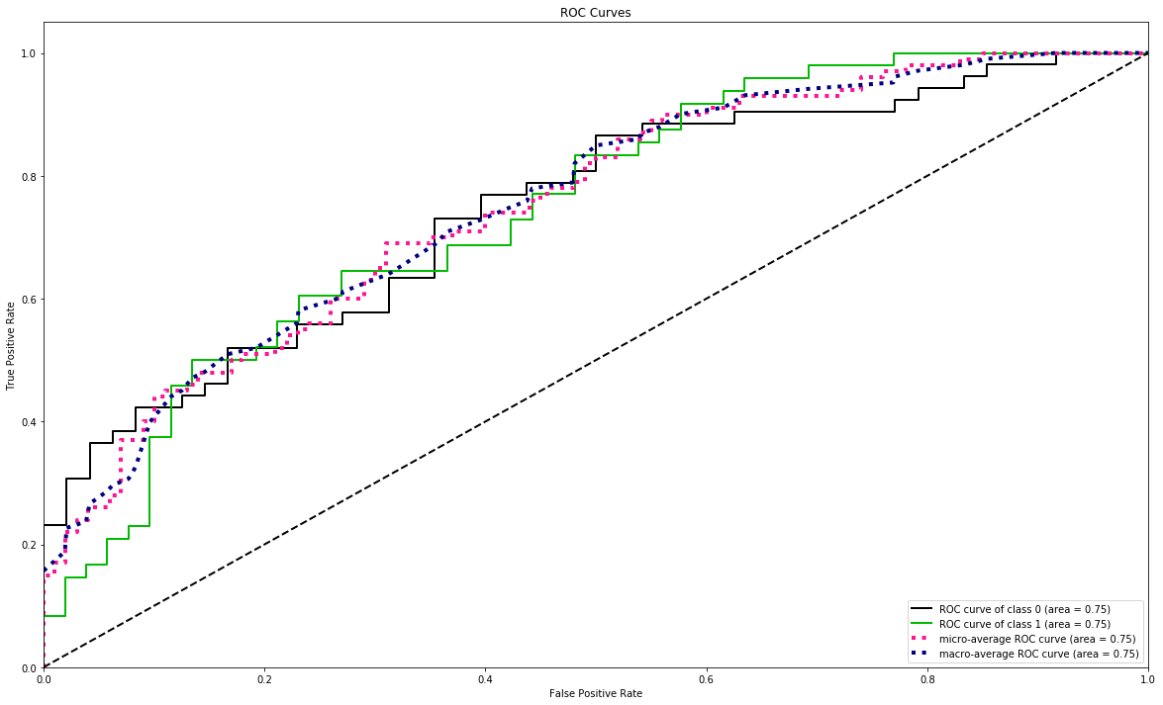
A*STAR Dataset – Training ROC Curves
Area under ROC curve is 0.75 for RIGHT Motor Imagery and IDLE class

Slide 26
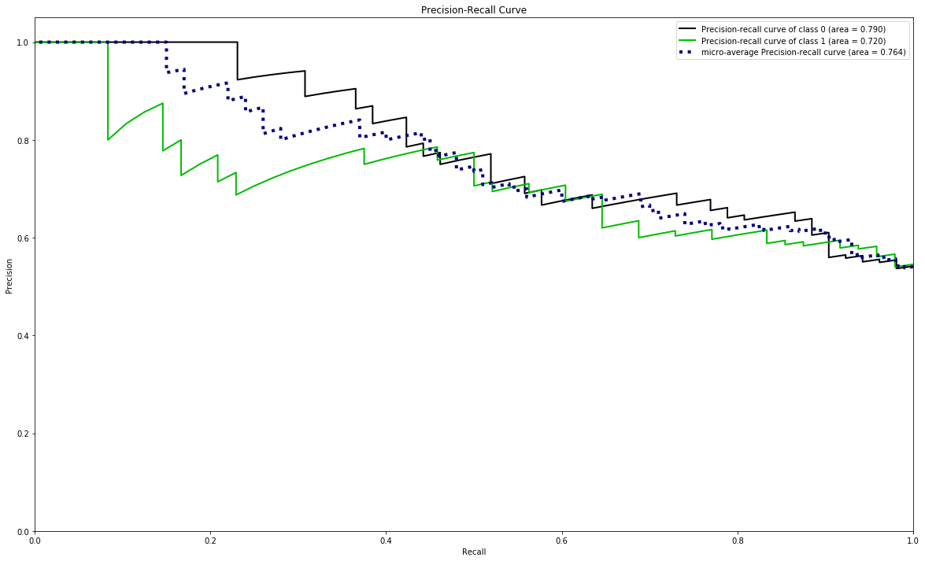
A*STAR Dataset – Training Precision-Recall Curve
Area under Precision-Recall curve is 0.790 for RIGHT Motor Imagery class
Area under Precision-Recall curve is 0.720 for IDLE class

Slide 27
A*STAR Dataset Test Precision Recall Values
 | Precision | Recall | f1-score | support
IDLE | 0.40 | 0.34 | 0.36 | 405
RIGHT_HAND | 0.43 | 0.49 | 0.46 | 406
Micro Avg | 0.41 | 0.41 | 0.41 | 811
Macro Avg | 0.41 | 0.41 | 0.41 | 811
Weighted Avg | 0.41 | 0.41 | 0.41 | 811

Slide 28
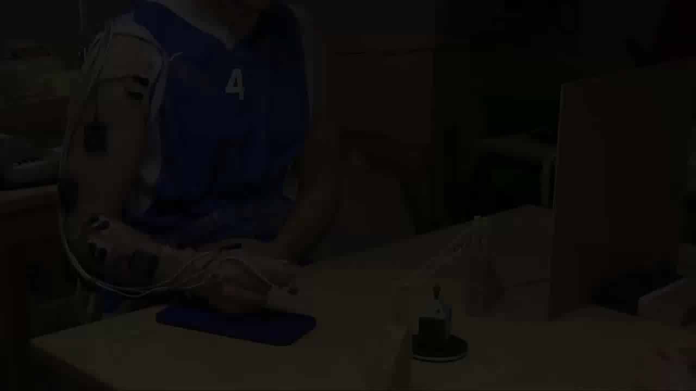
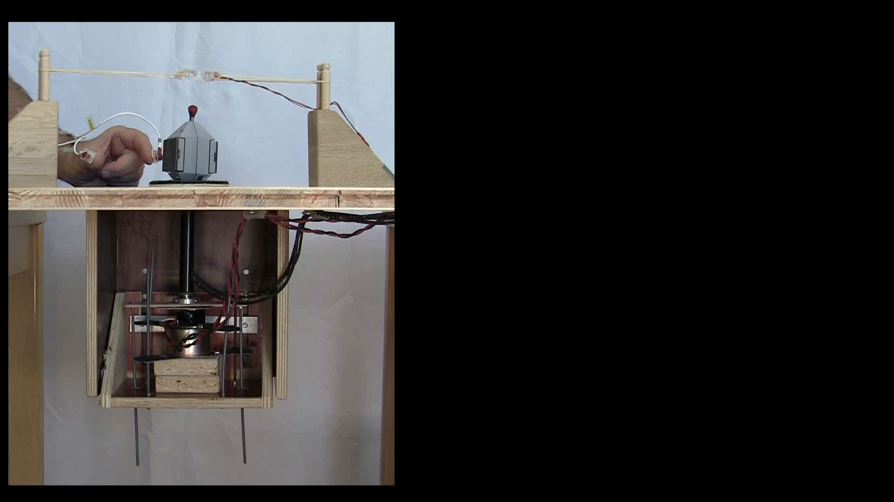
Operational Context – Open Source Dataset
Grasp and Lift (GAL) experiment were carried out among healthy subjects
Conducted in the same order for all 12 subjects
Similar to A*STAR dataset, the signal data is stored and pre-processed before being used for Training and Validation of the intended models

Slide 29
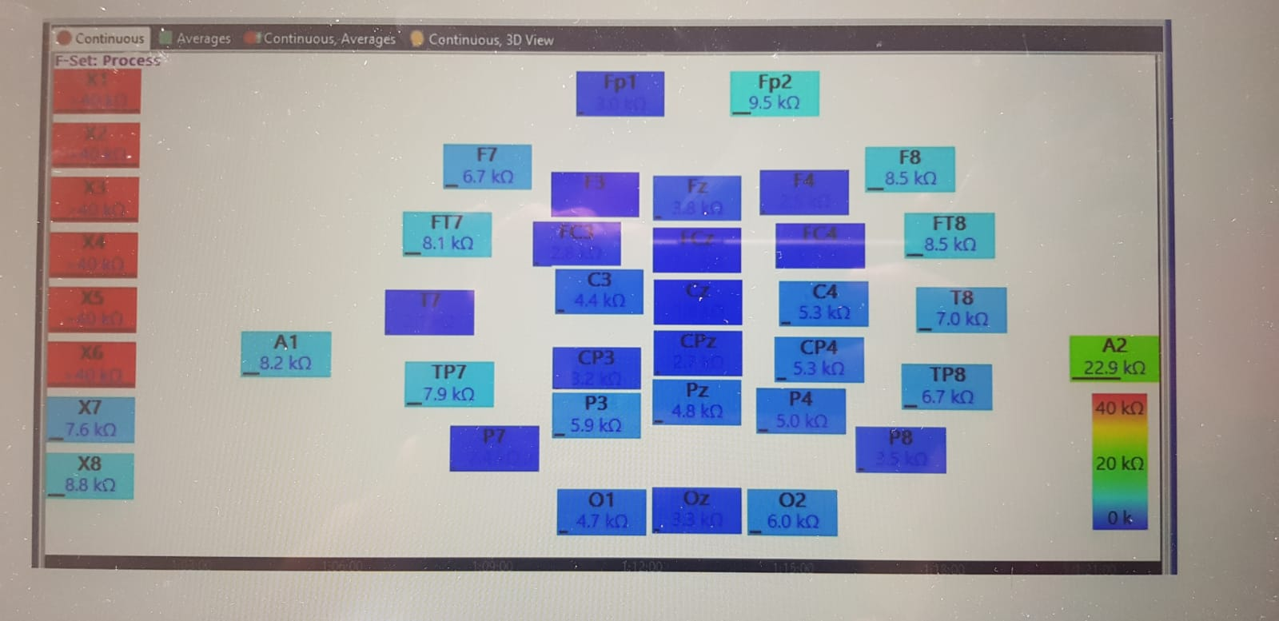
Operational Context – ALS Affected (A*)
Quik-cap with 40 electrodes to record EEG Signals
Placed on scalp of ALS affected subject
Reference of A1 and A2 placed at left and right ear lobe respectively
Impedance of each channel are kept below 10 kΩ
Subjects instructed to imagine left, right hand movement
EEG signals collected and filtered (4 to 40 Hz) before passing it to the model.
Figure 3: Impedances of electrodes on ALS patient’s scalp

